Slide 1

Introduction to IoT ,Architecture and Applications
DAY 5
EMBEDDED SYSTEM DESIGN & IoT-Master Class

Slide 2
What You will learn Today?
Introduction to IoT
Trends, Challenges, IoT Architecture
IoT Taxonomy
AI+IOT
IoT Applications
What is Thing speak and How it works
What is AWS IoT and How it works

Slide 3
Mindset Lesson for the Day
Your Environment is stronger than your will power
Exercise
Write down everything you can think of that would improve your current work environment

Slide 4
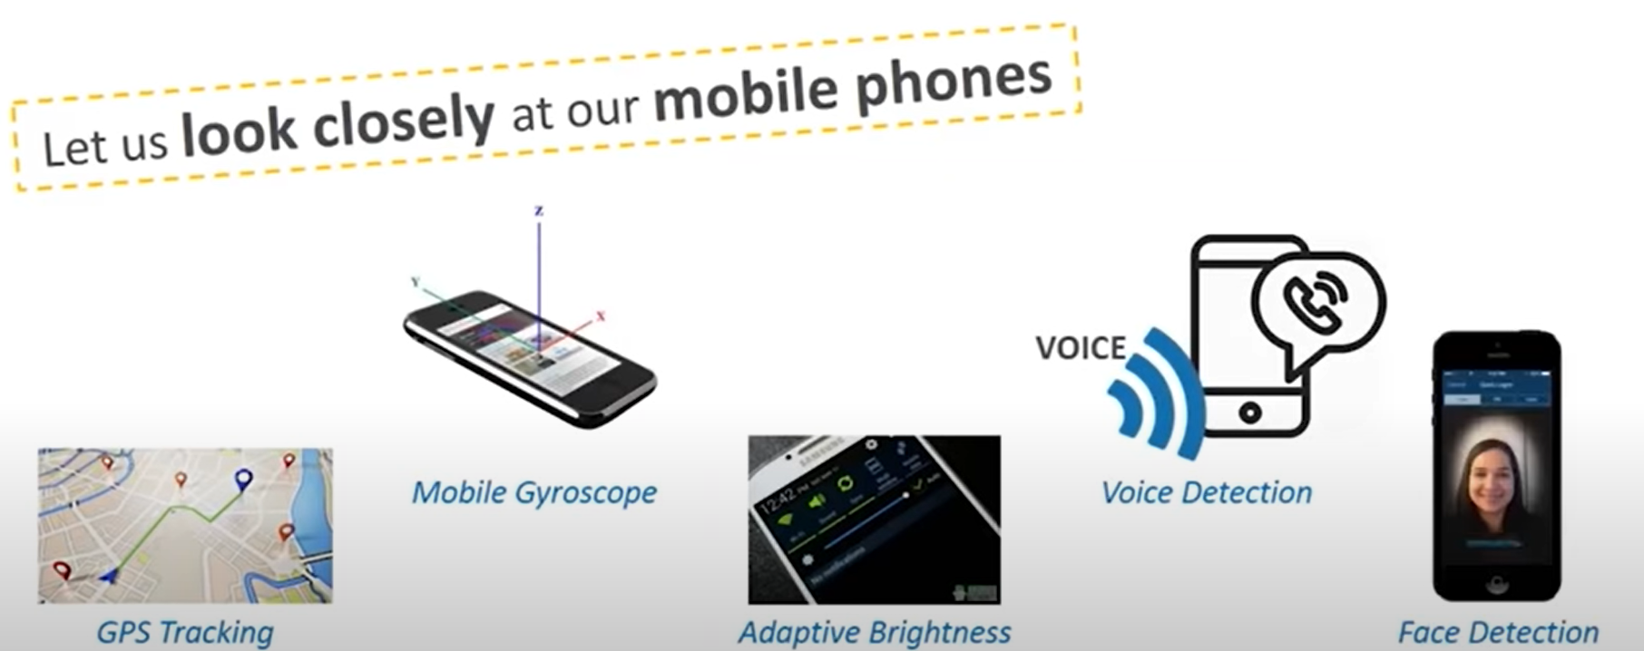
What is Internet of Things

Slide 5
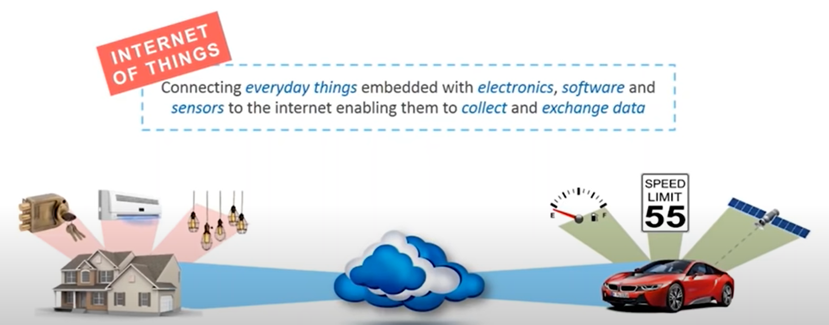
What is Internet of Things

Slide 6
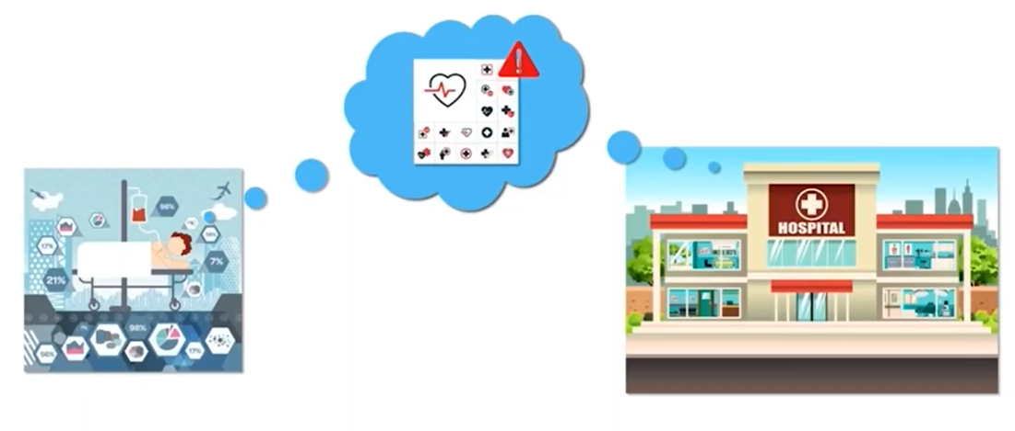
Why do we need IoT

Slide 7
Benefits of IoT
Efficient Resource Utilization
Minimizing Human Effort
Saves Time
Development of AI through IoT(Personal assistant like siri,alexa)
Improved Security

Slide 8
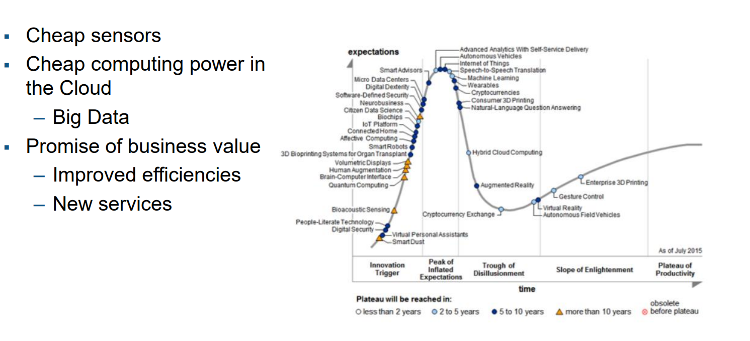
Trends Driving IoT

Slide 9
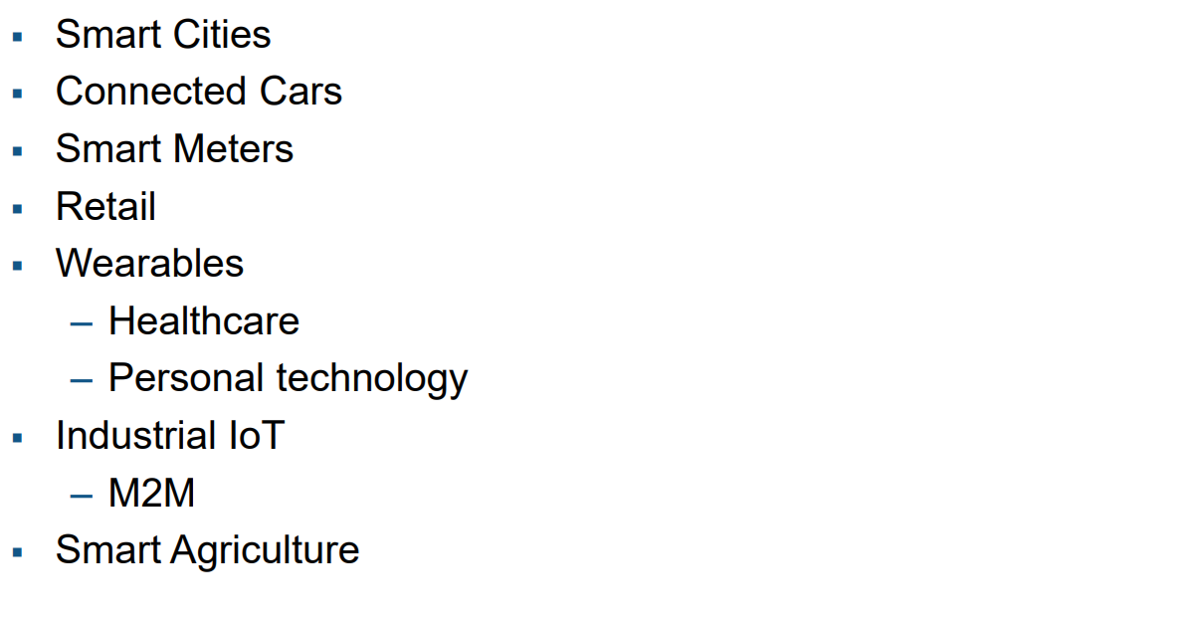
Markets Driven by IoT
50 Billion Devices will be connected to internet in 2025

Slide 10
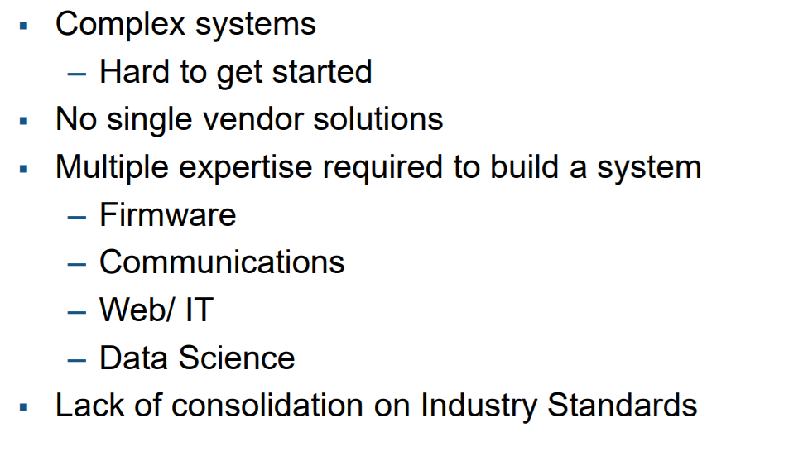
Challenges of IoT

Slide 11
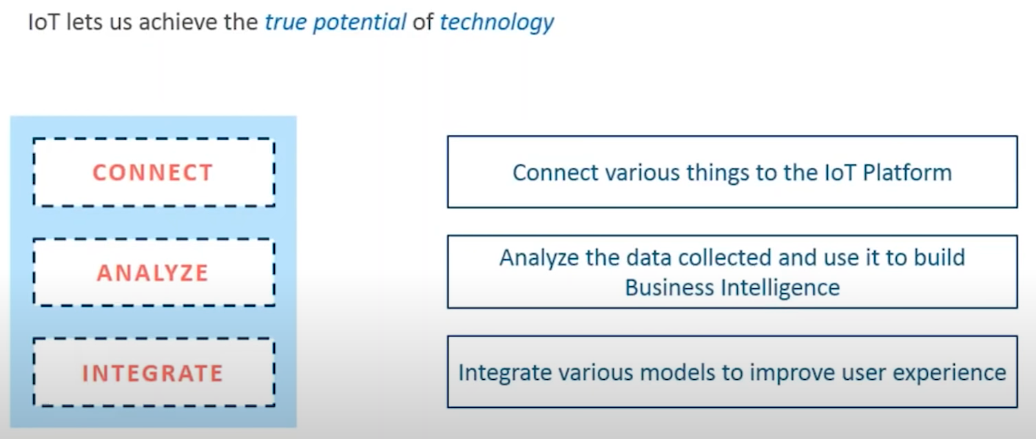
IoT Features

Slide 12
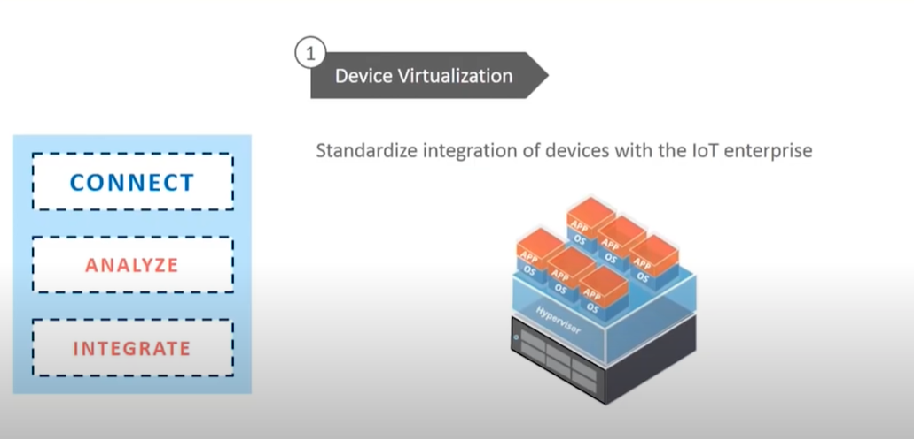
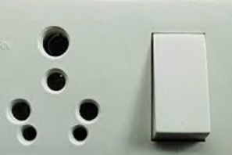
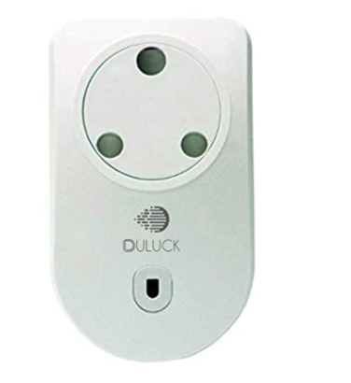
IoT Features

Slide 13
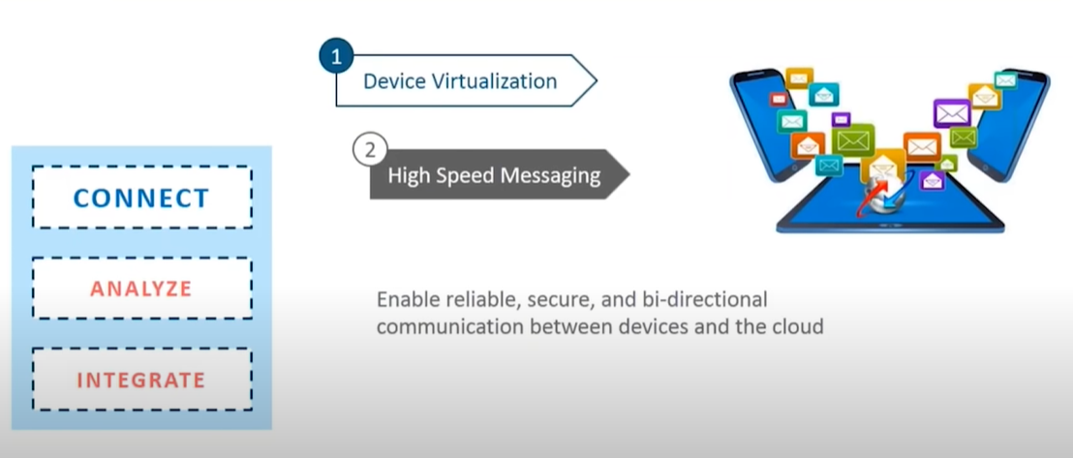
IoT Features

Slide 14
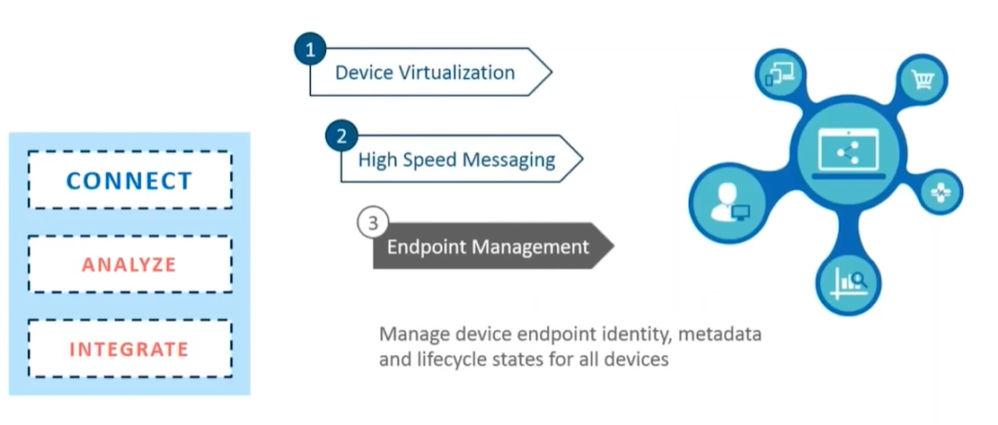
IoT Features

Slide 15
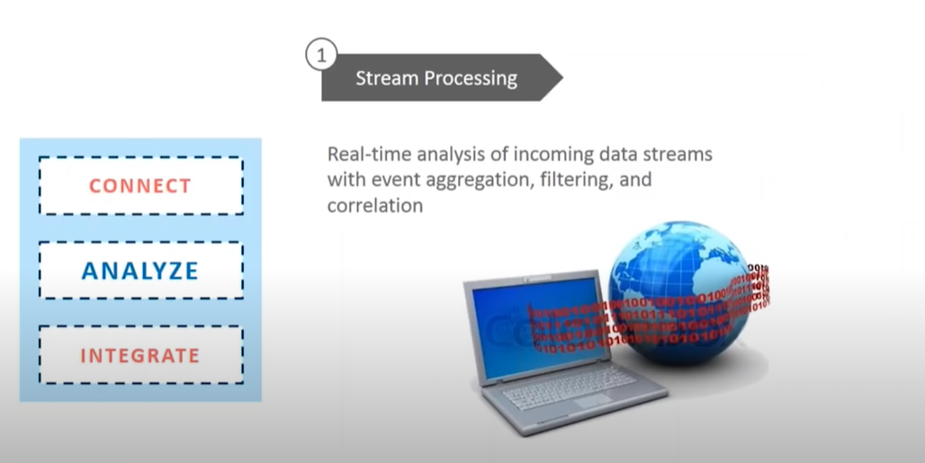
IoT Features

Slide 16
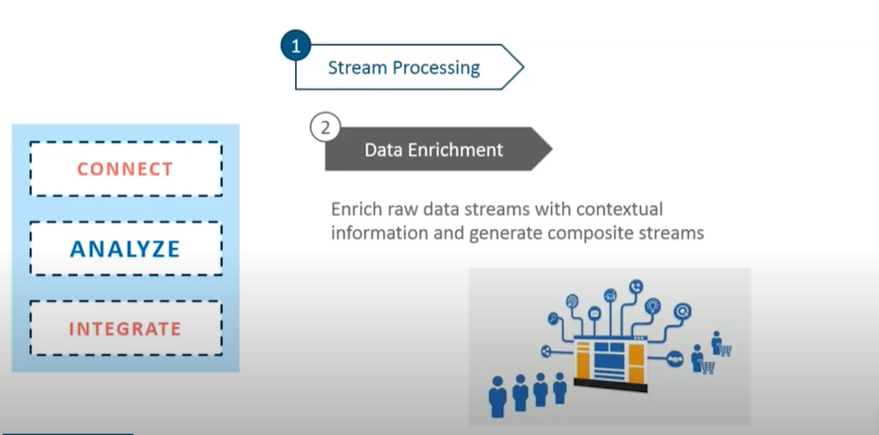
IoT Features

Slide 17
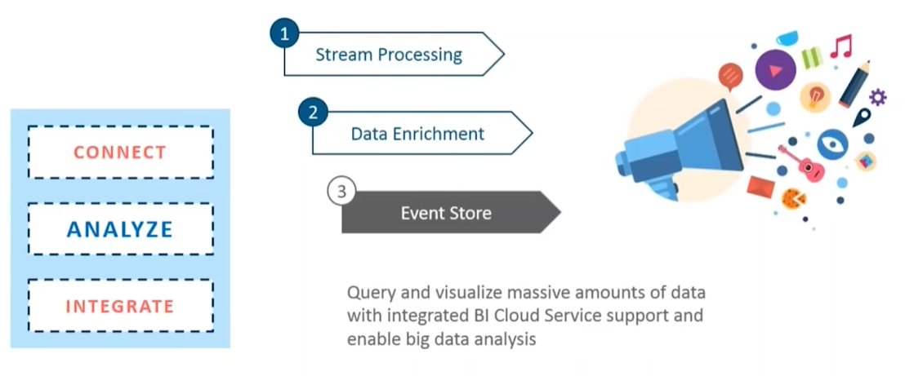
IoT Features

Slide 18
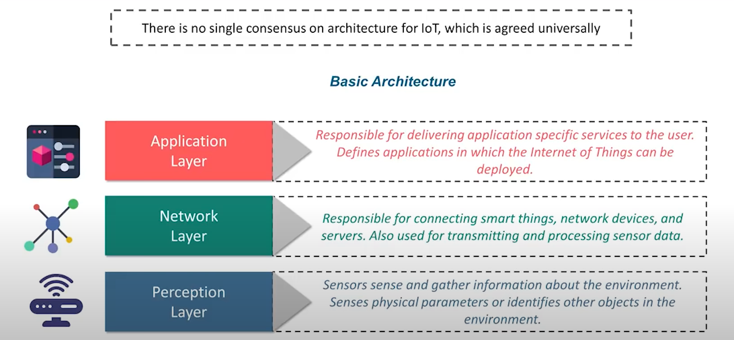
IoT Architecture

Slide 19
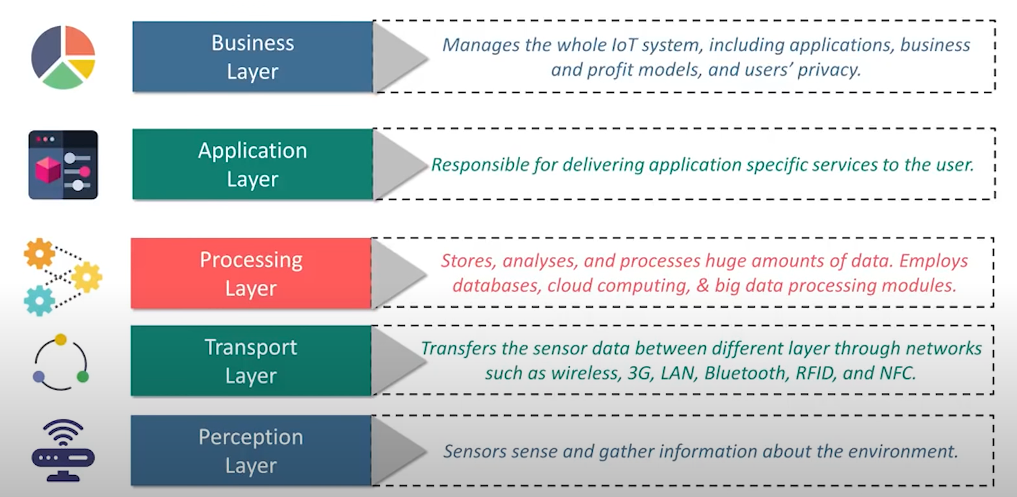
IoT Architecture -5 Layers

Slide 20
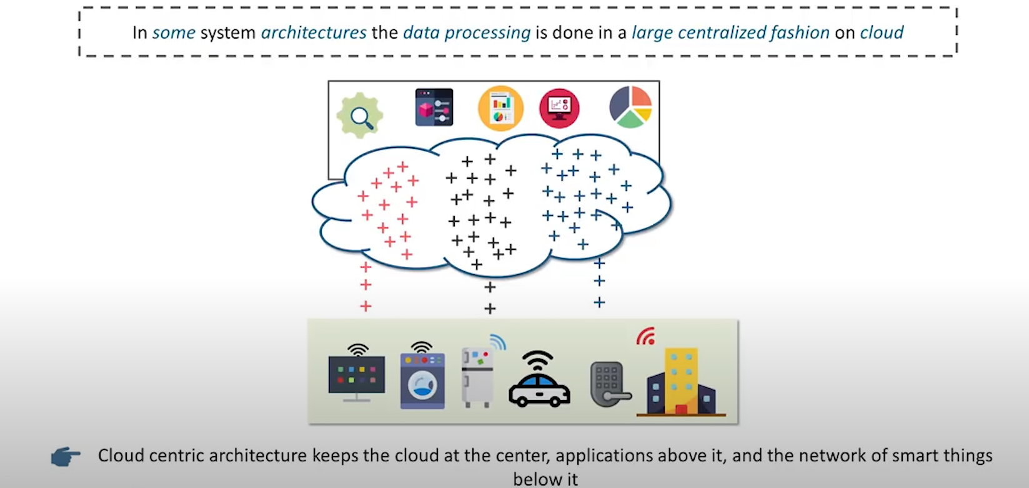
Cloud Computing in IoT

Slide 21
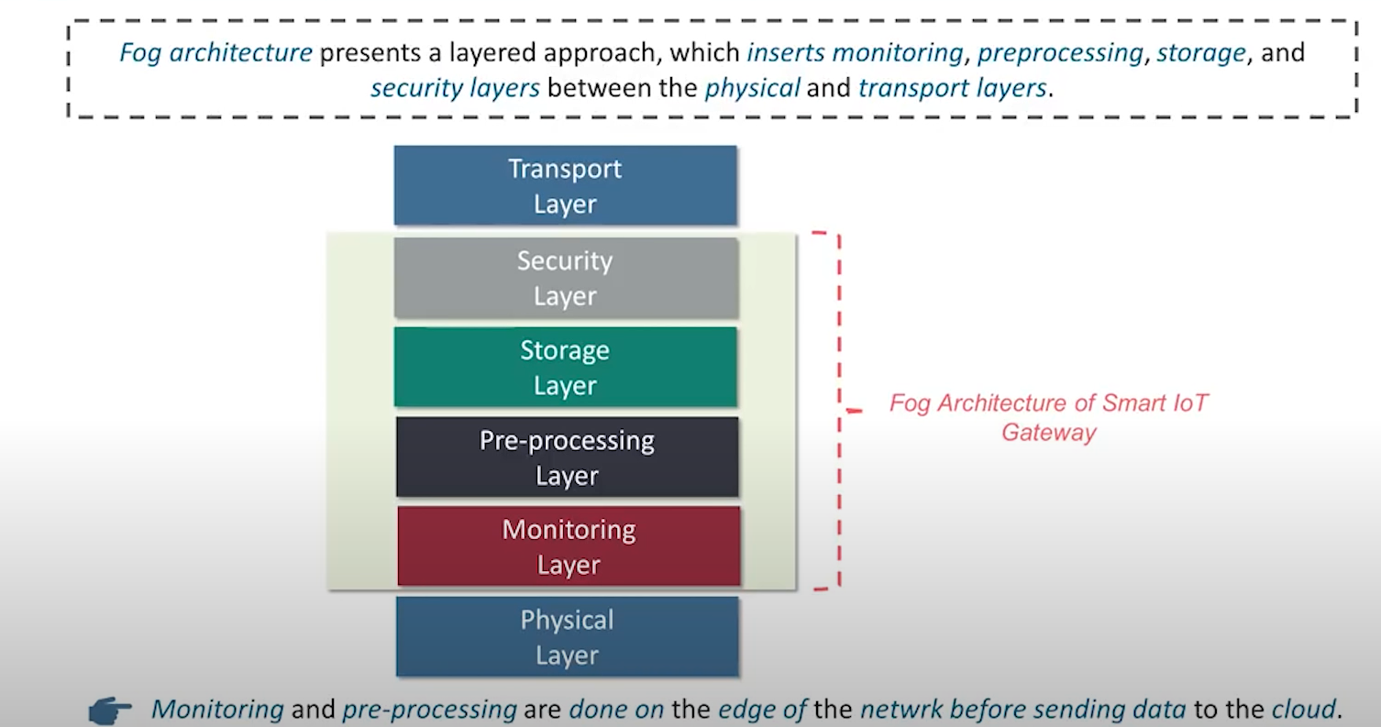
FOG Computing in IoT

Slide 22
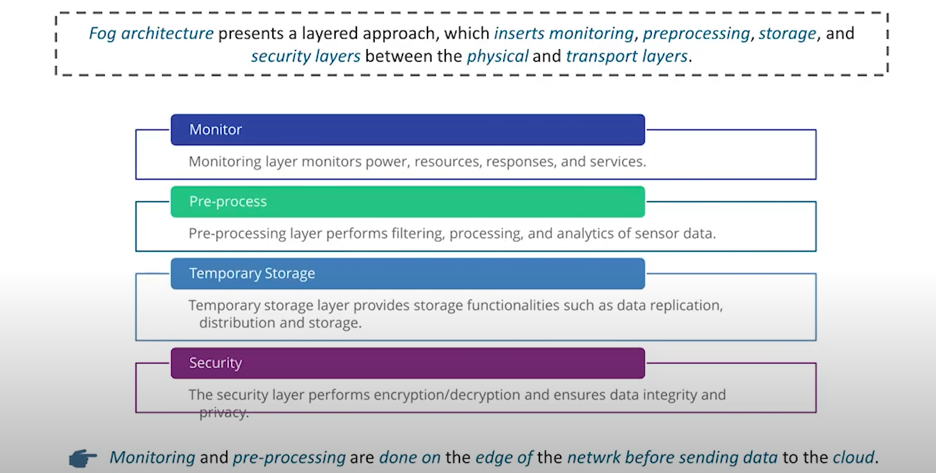
FOG Computing in IoT

Slide 23
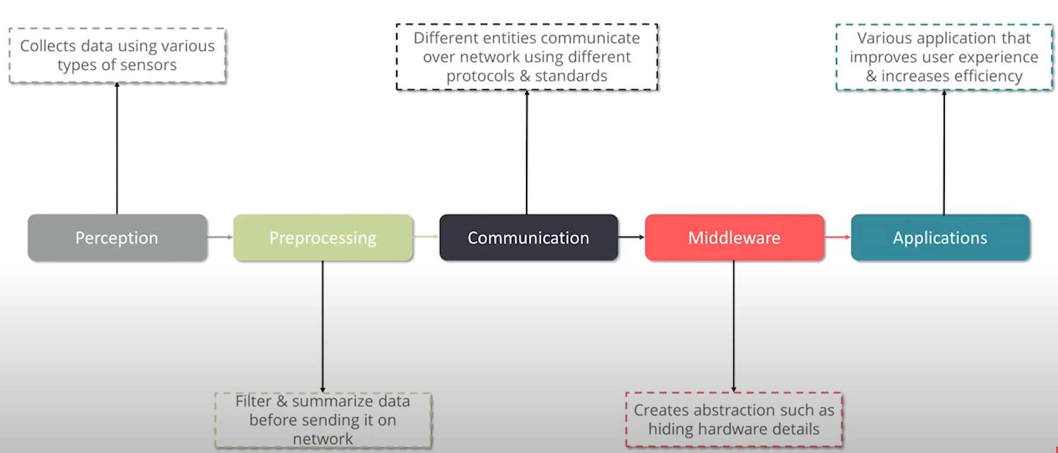
IoT Taxonmy

Slide 24
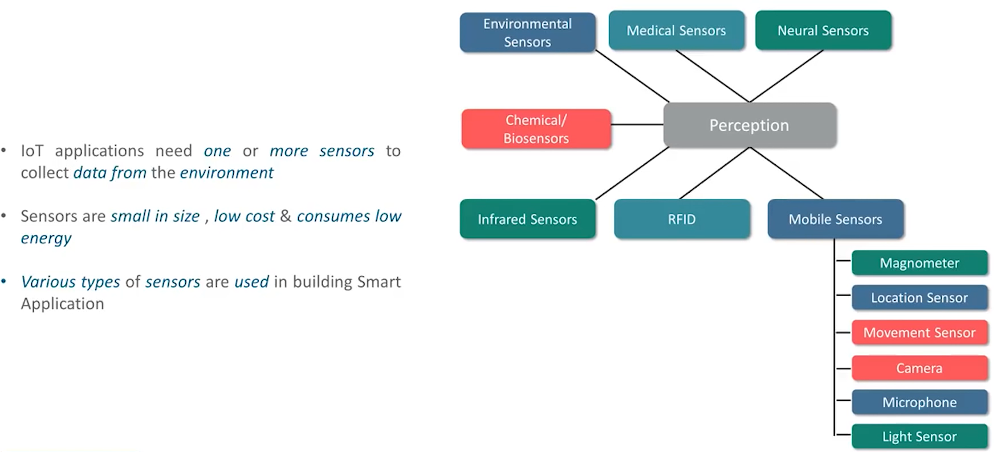
Perception

Slide 25
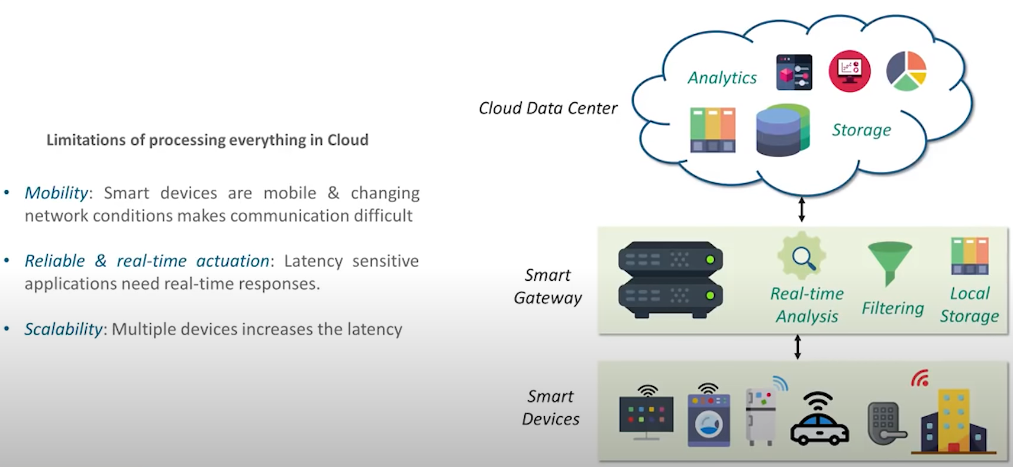
Preprocessing

Slide 26
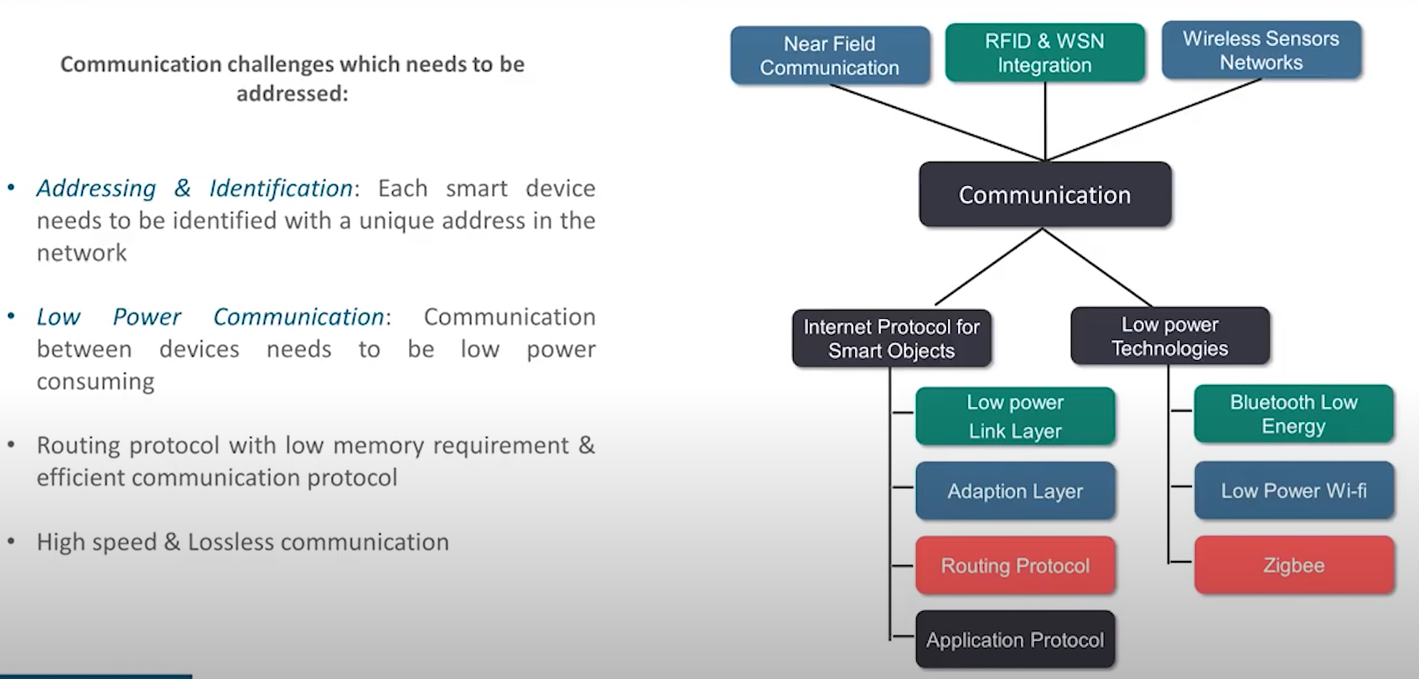
Communication

Slide 27
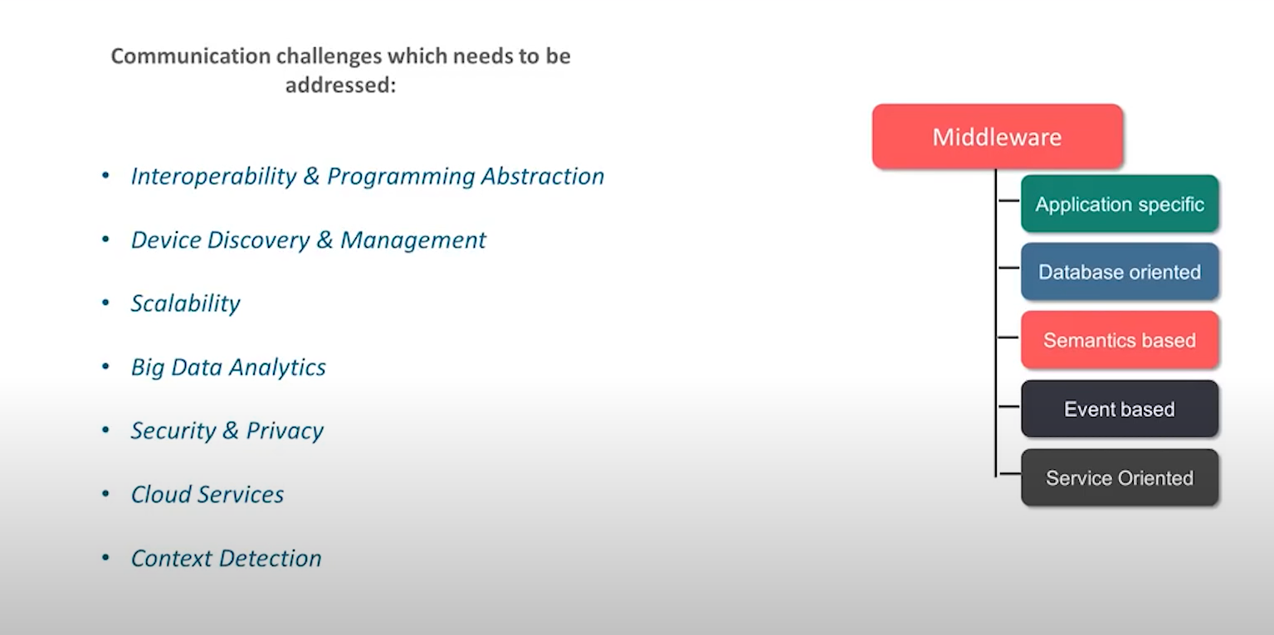
Middleware

Slide 28
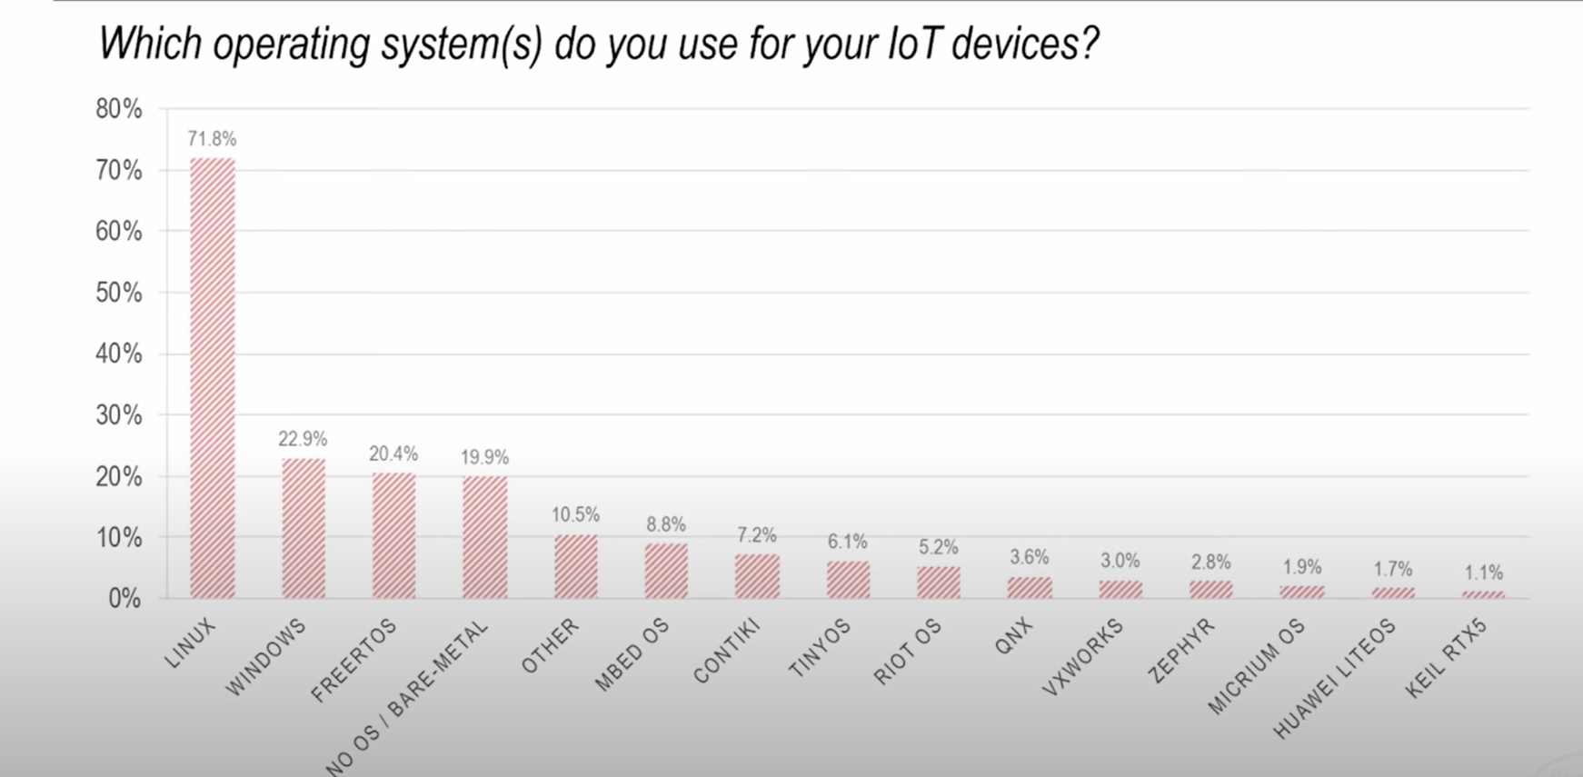
IoT Operating system

Slide 29
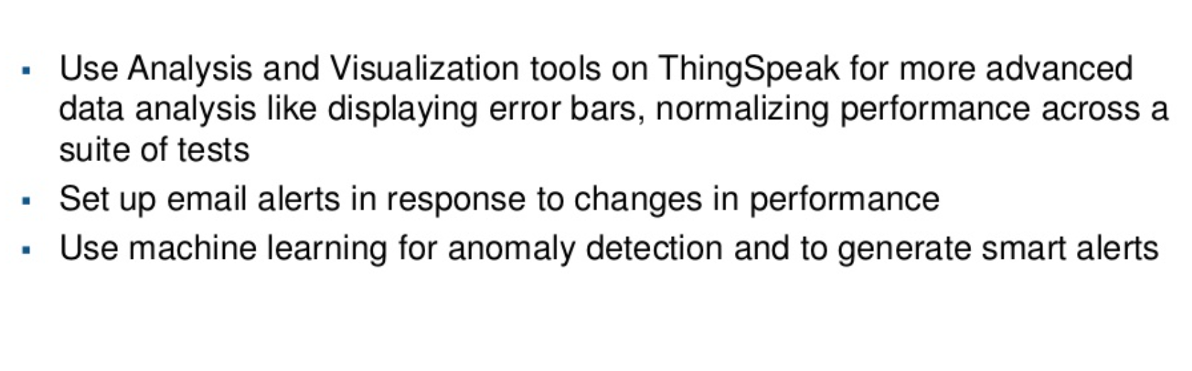
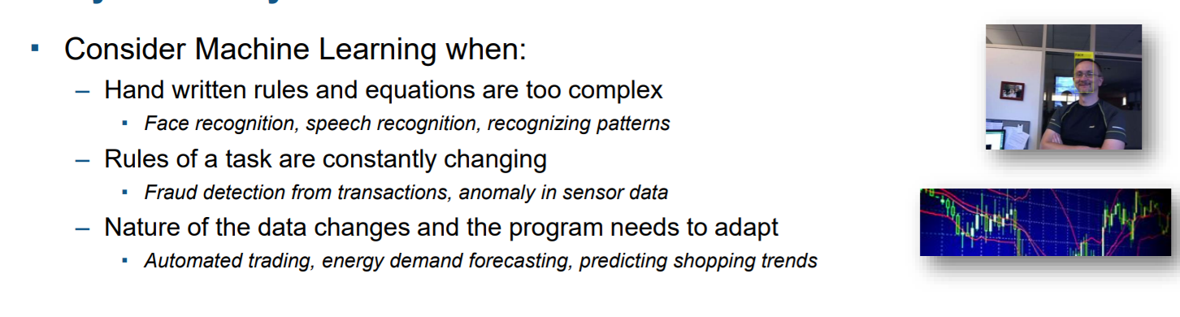
Why AI +IoT ?

Slide 30
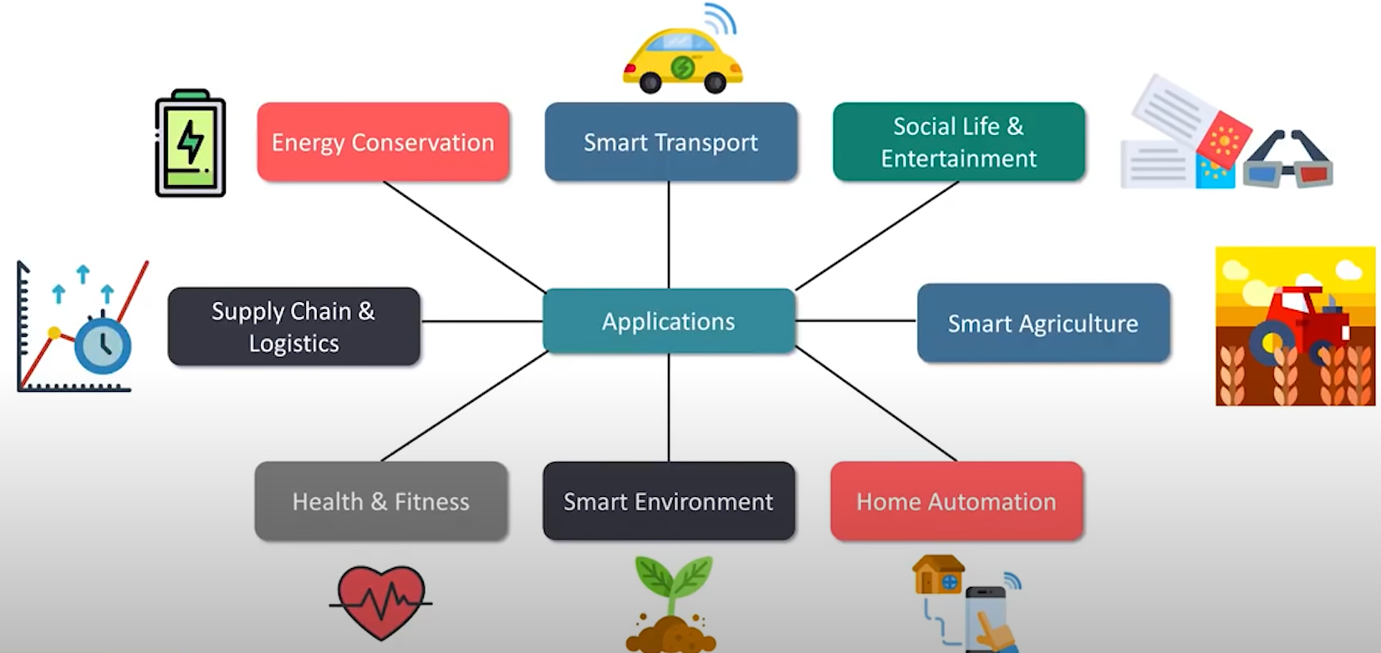
Applications

Slide 31
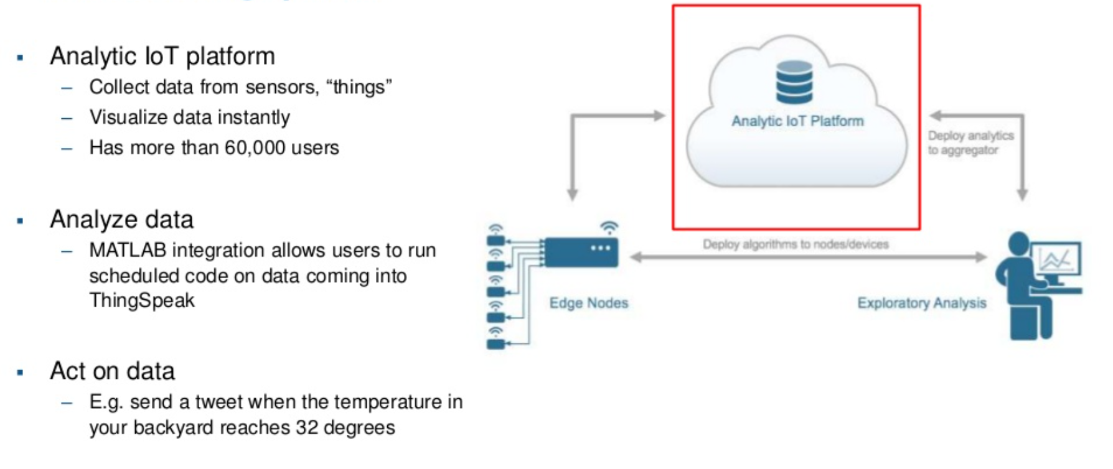
What is Thingspeak

Slide 32
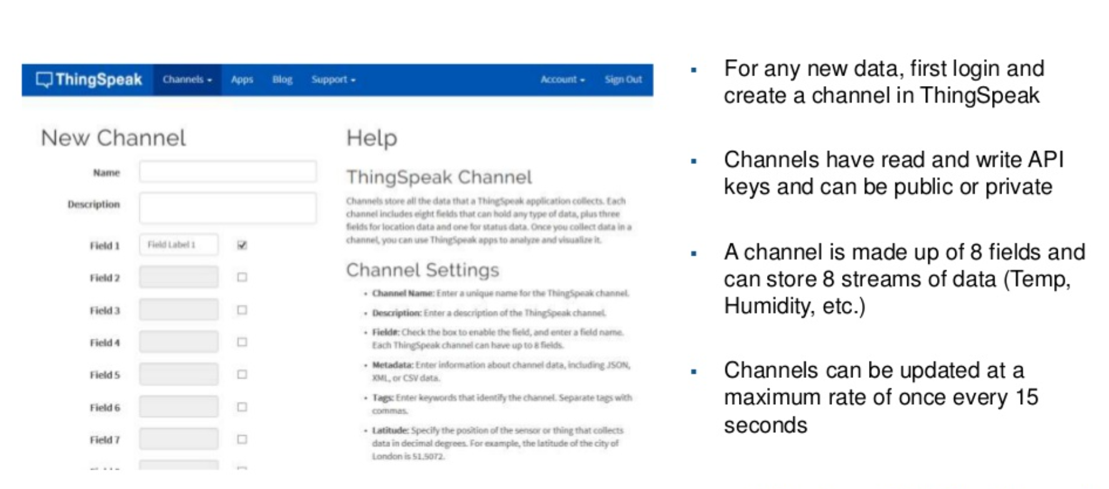
Thingspeak-Collecting data using Channels

Slide 33
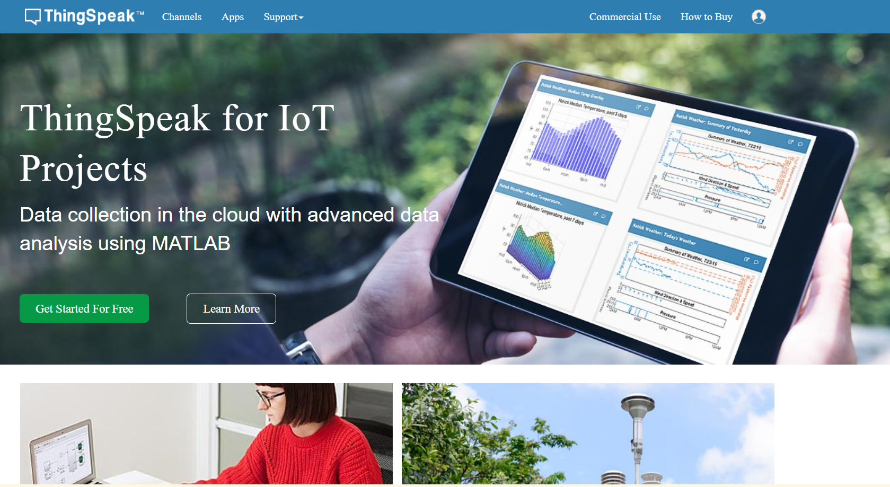
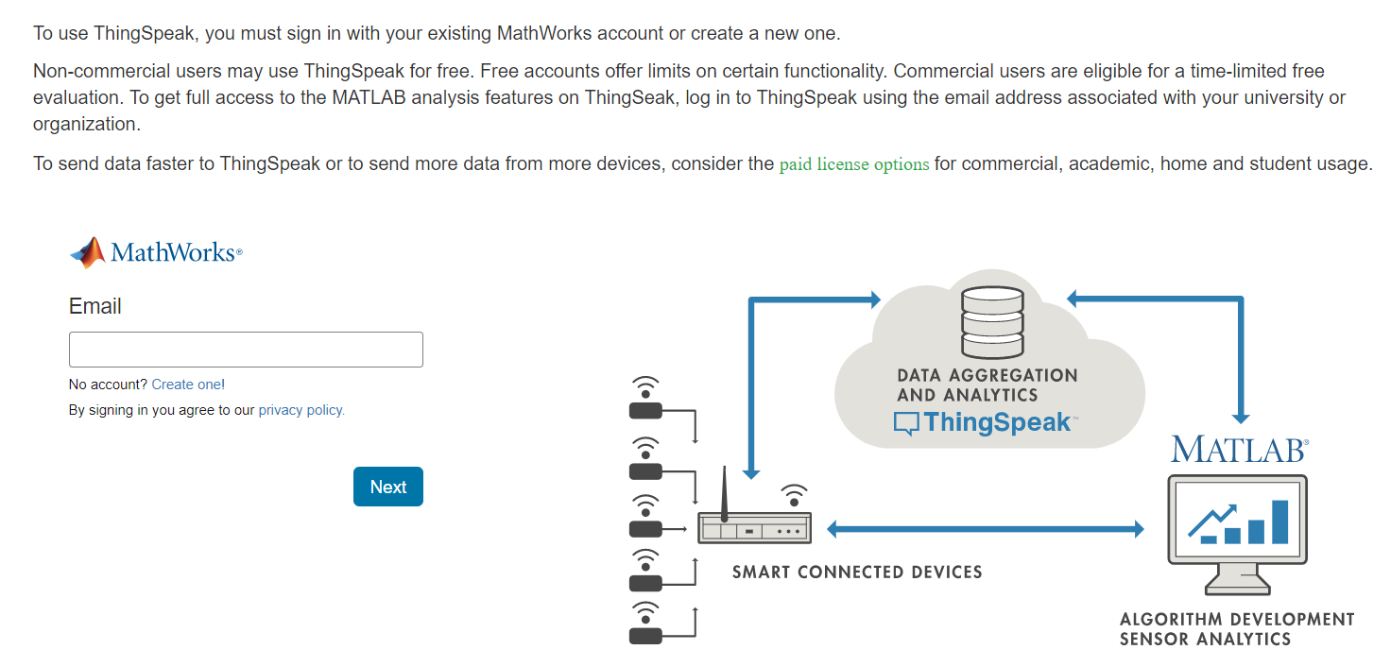
Create an Account
https://thingspeak.com/

Slide 34
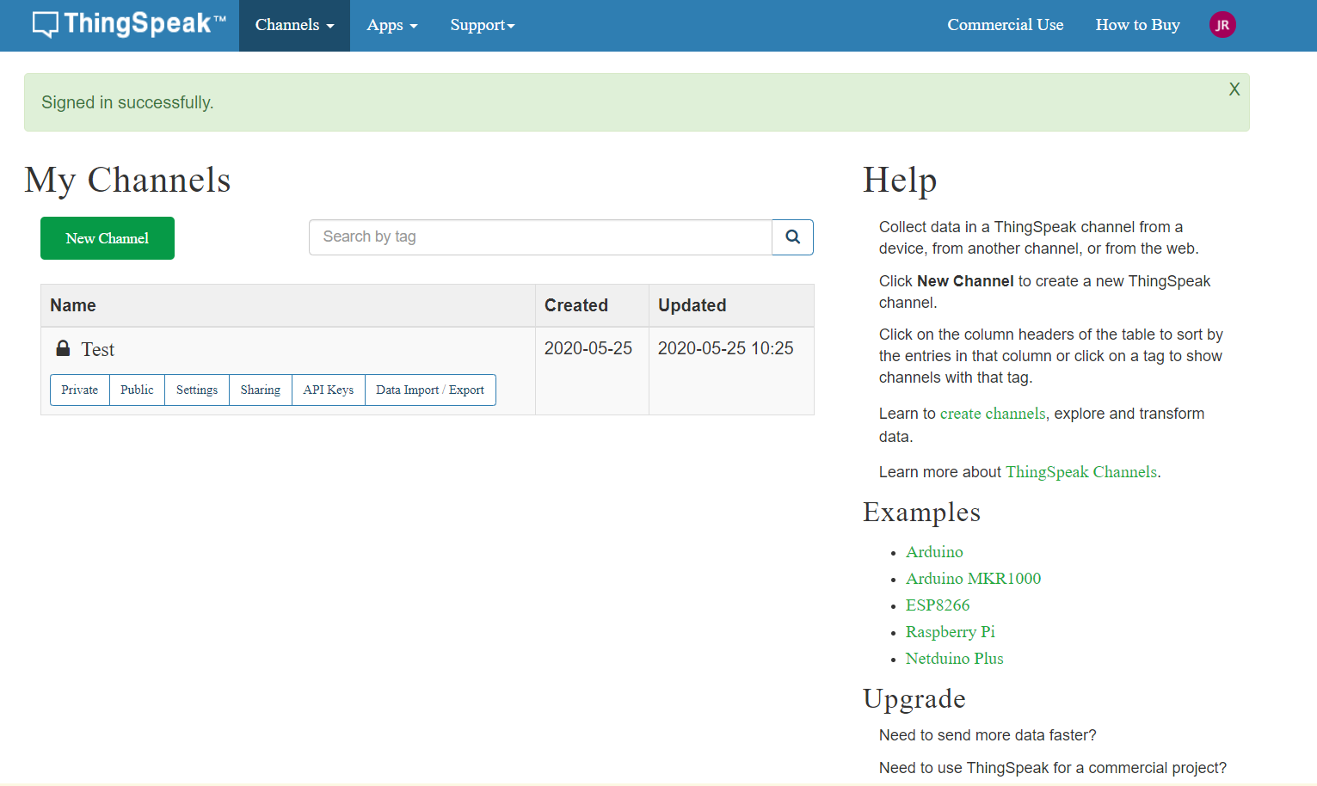
Home Page

Slide 35
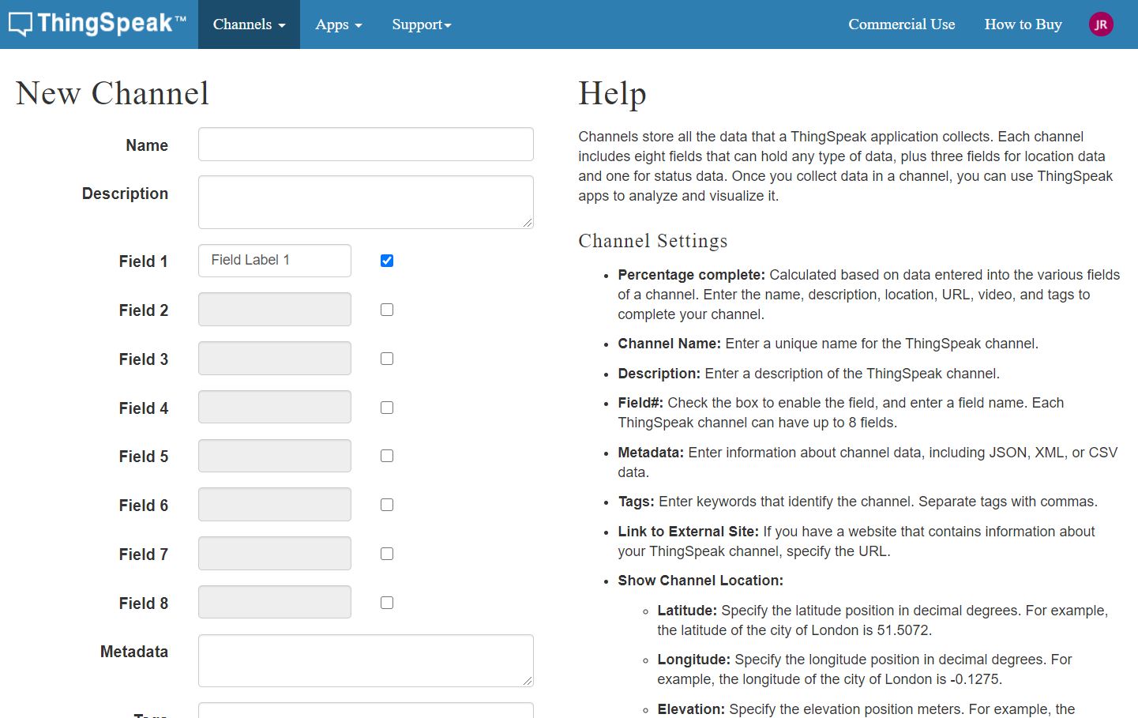
Channel Dashboard

Slide 36
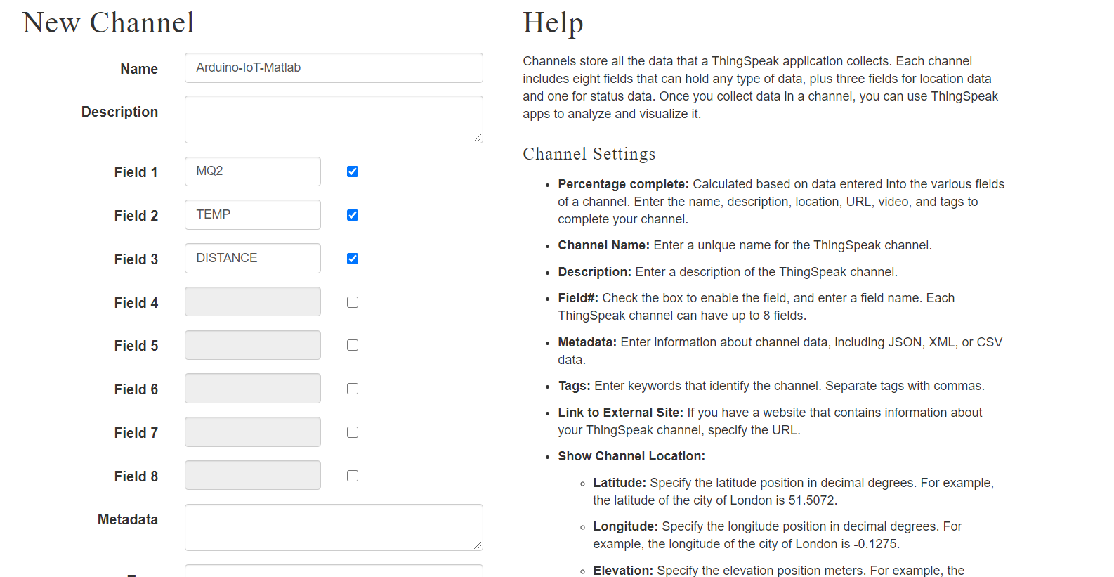
Create fields

Slide 37
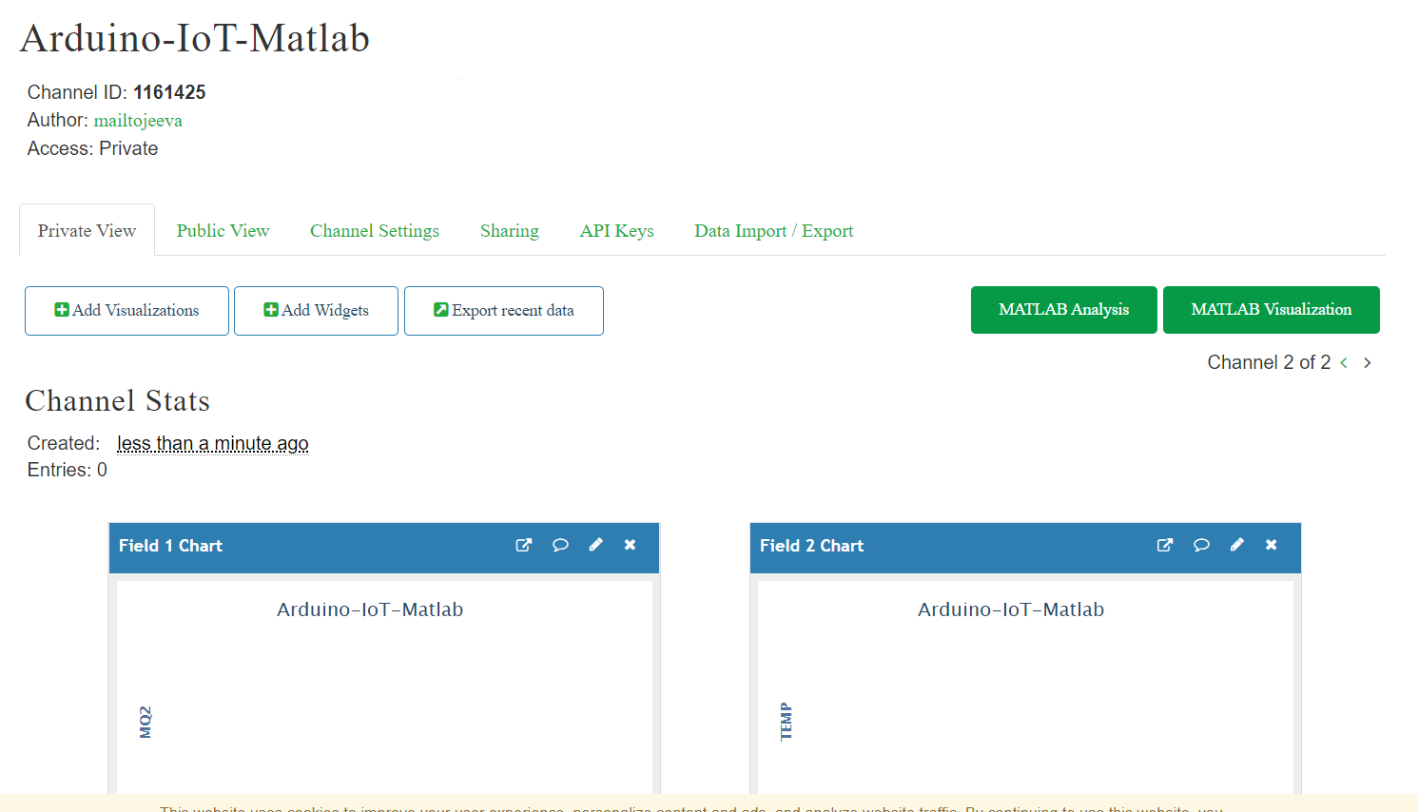
channel Created

Slide 38
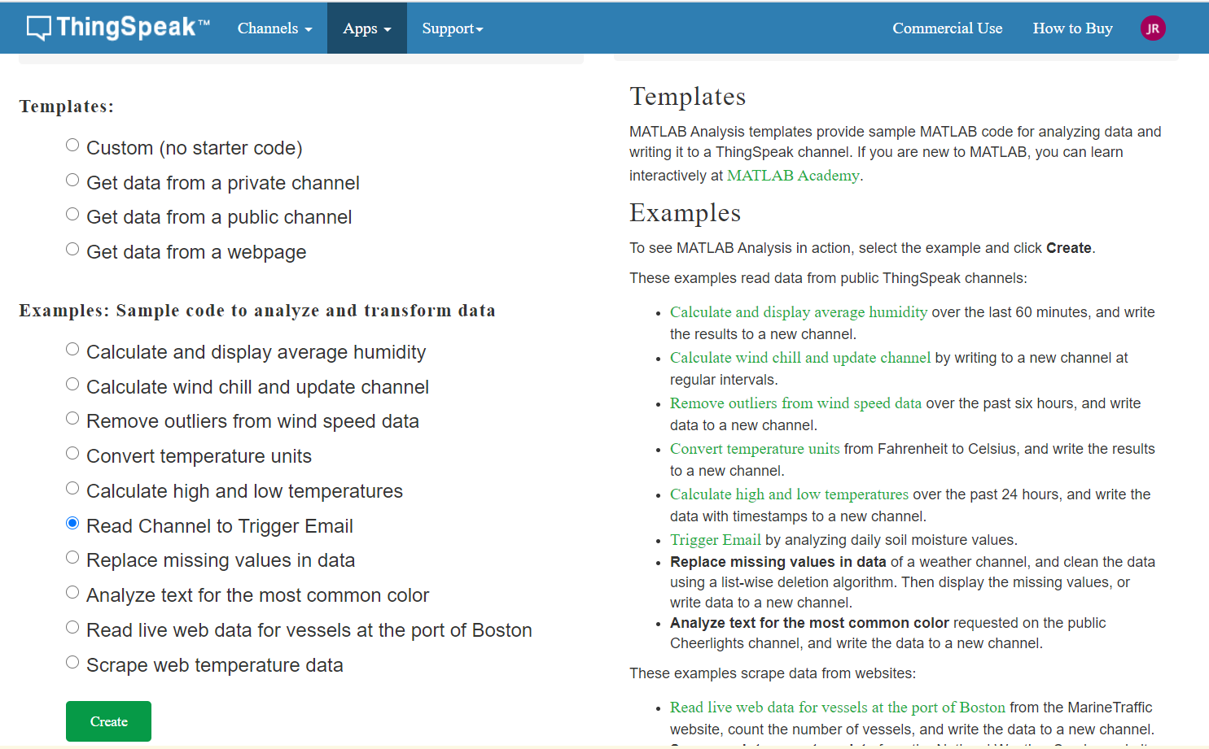
Create a template

Slide 39
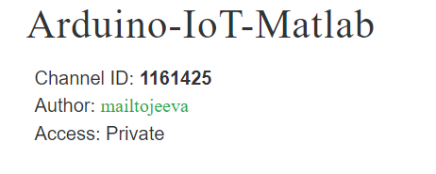
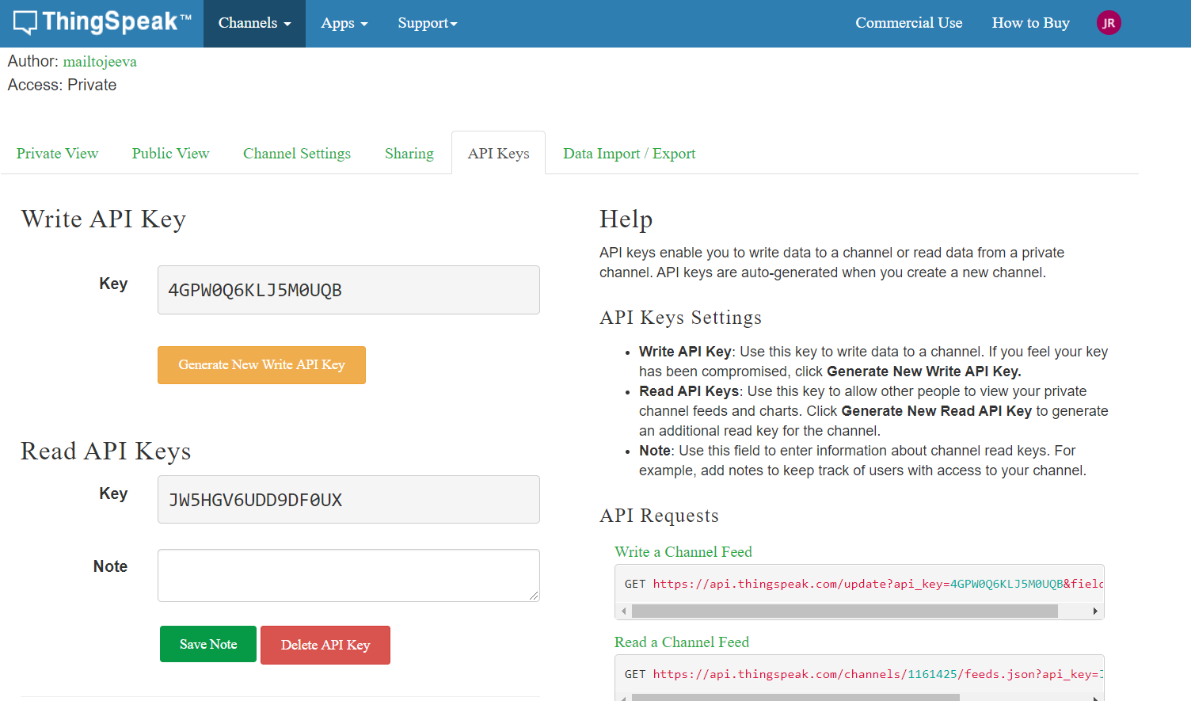
Read and Write API Keys

Slide 40
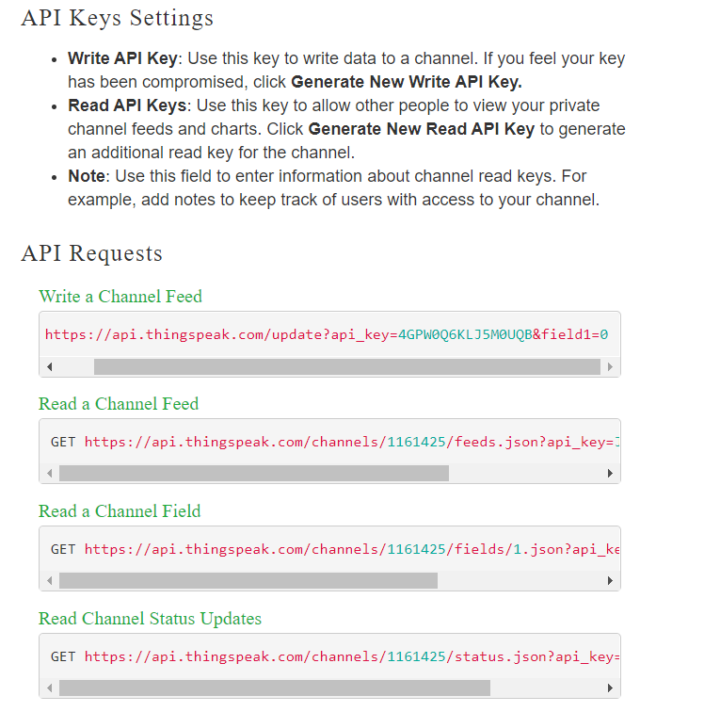
API Key Settings

Slide 41
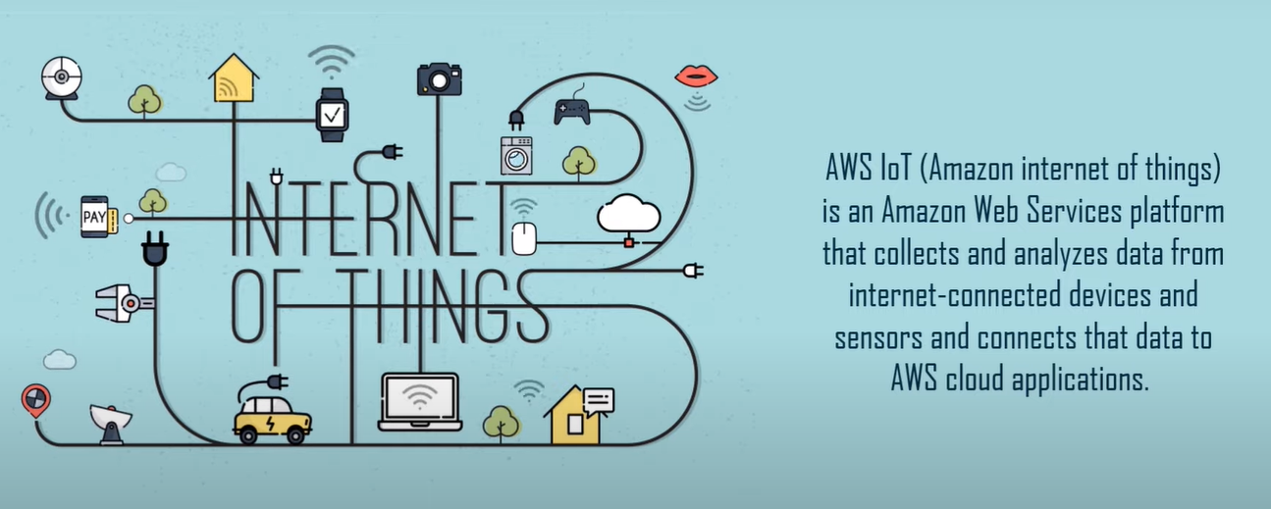
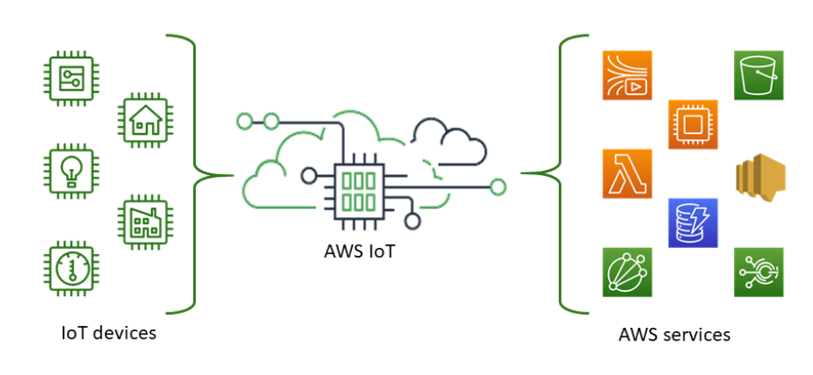
What is AWS IoT

Slide 42
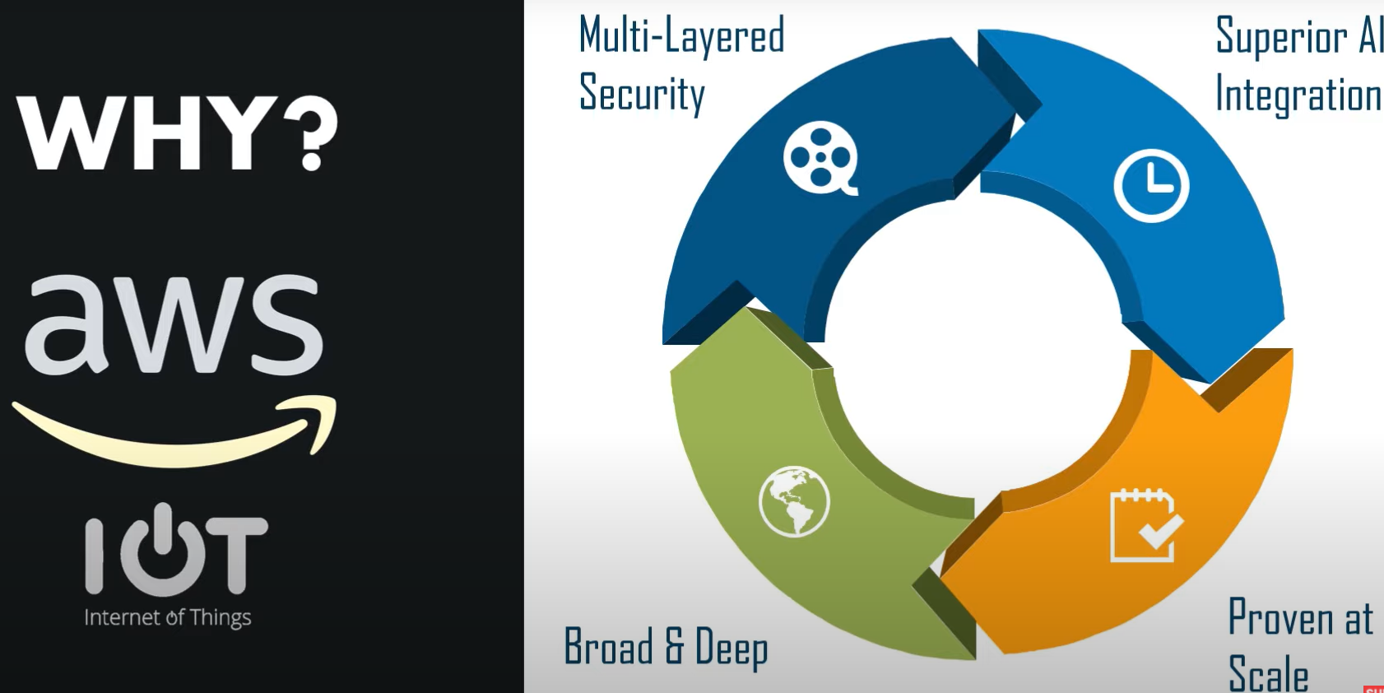
Why AWS IoT

Slide 43
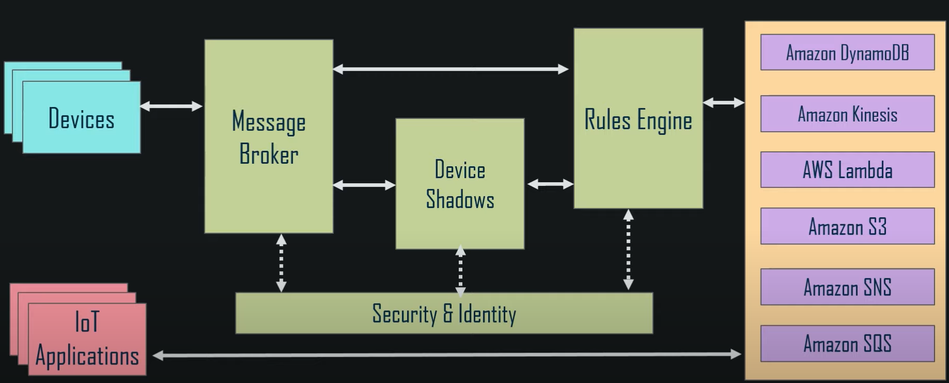
How it Works

Slide 44
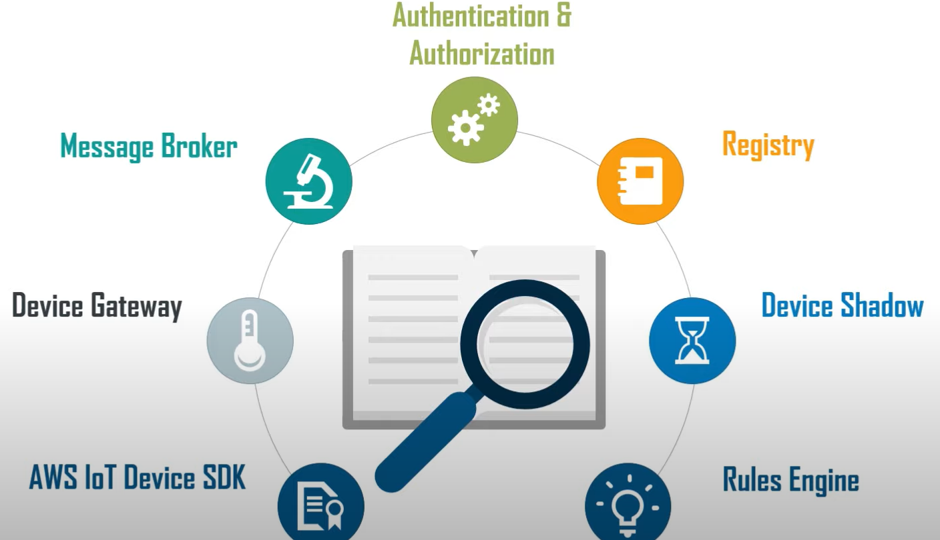
How it Works

Slide 45
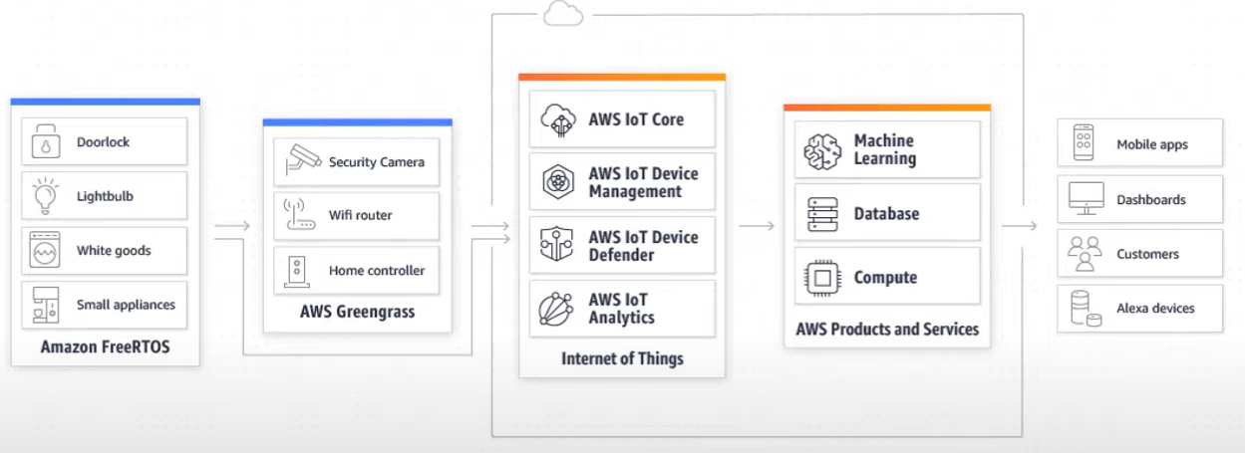
LG –Smart Home

Slide 46
Recap
Introduction to IoT
Trends, Challenges, IoT Architecture
Iot Taxonomy
AI+IOT
IoT Applications
What is Thing speak and How it works
What is AWS IoT and How it works

Slide 47
Thank You

